Slide 1
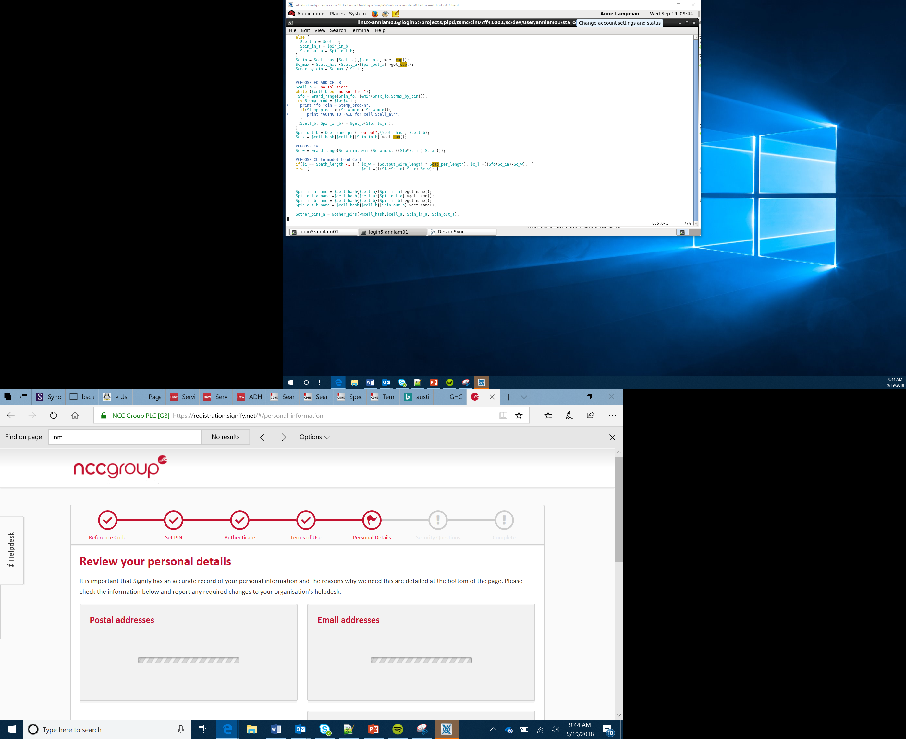

Light Follower
Lesson 7

Slide 2
Objectives
Be able to use sensors to detect the environment
Be able to use code to take a reading from the light sensor
To be able use selection to change actions based on a sensor reading

Slide 3
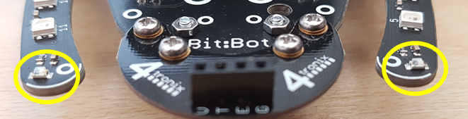
Light Sensor
We have already looked at how the light sensor works by writing a digital signal to Pin 16 and the reading back an analogue value
To simplify this process Bit:Bot has some pre-defined blocks to get you up and running quickly
Notes:
Re-introduce the concept of analogue data in the terms of a data range with a min and max value
Remind Learners of how we used the light sensor and how we used a digital signal to enable or disable the left and right sensor
Remind Learners how to add the Bit:Bot extension

Slide 4
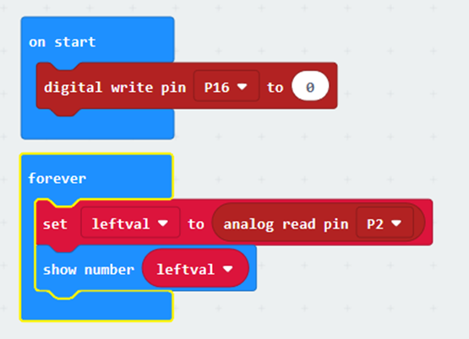
Light Sensor – Direct Connection
In the example on the right we:
Use Pin 16 to select which sensor (left = 0 or right = 1) is being used
Take an analogue reading from Pin 2
The range of values returned is between 0 and 1023 (the sensors minimum and maximum values)
Notes:
Explain that the light sensor can be accessed directly, this is especially useful if we are using a sensor that is not part of the Bit:Bot
Explain that as there are two sensors on the Bit:Bot we have to switch Pin 16 on or off to enable the left or right sensor
If you are using a stand alone sensor you need to know the pin number of the switch
Show the blocks and give the students a chance to experiment by reading the light levels and displaying to the screen

Slide 5
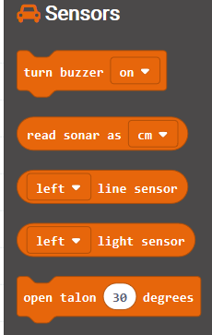
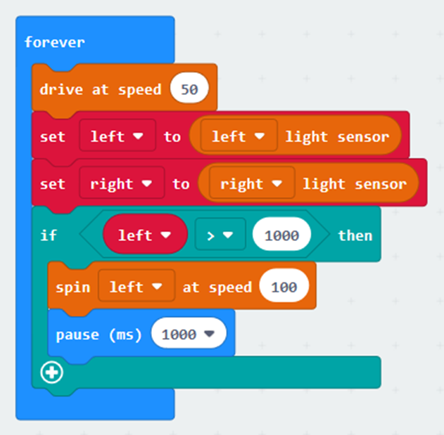
Light Sensor – Bit:Bot Extension
By adding the extension for Bit:bit we are able to simplify the use of the light sensor through a single block
Try the example code below
Notes:
Remind Learners that the built in Bit:Bot blocks make life simpler
Show the built in block for using the left and right sensor and how this simplifies this process
Use the code to demonstrate how the sensor data can be processed using selection and how we can get the robot to react.
Give the Learners an opportunity to experiment
Make a point of trying the sensor in different levels of brightness for the room and how this impacts on the sensor data reading

Slide 6
Light Sensor – Bit:bot Extension
The video shows how the robot could react to light
By using select statements for the left and right sensor you can either turn towards or away from the light
Look at the values required for the light sensor and how adjusting this impacts on sensitivity
Notes:
Set Learners a challenge using the sample code here to use both sensors and either run away or towards the light
Little video shows how the Bit:Bot might react

